Slide 1
Sentiment Analysis & Text Mining
"Cleaning Twitter sentiment to predict Nvidia’s next move"
Rafael Condé Gomes, Travis Race, James Angeles, Anthony Nance, Matthew Humphreys

Slide 2
Introduction: Predicting Nvidia's Moves with Twitter Sentiment
Project Goal:
Predict NVDA stock movement (Up/Down) using Twitter sentiment.
Frame it as a binary classification problem.
Data Collection & Cleaning:
Pulled ~90,000 tweets ("Nvidia" or "NVDA").
Dropped blanks, promos, mass retweets.
Standardized timestamps (YY-MM-DD).
Class References:
Week 6: Introduction to Text Analysis
Week 3: Visualizing our data
Week 8: Lining Up Our Models
Week 11: Using Shiny Apps

Slide 3
Text Processing:
Lowercased words, stripped punctuation/hashtags/URLs.
Removed stop words (Week 7 list).
Tokenized sentences and scored sentiment using Bing lexicon.
Merging with Stock Data:
Pulled NVDA daily OHLC and volume from Yahoo Finance.
Merged tweet sentiment stats with stock returns and volumes.
Created a compact, numeric dataset (78 rows × 26 columns).
Modeling Approach:
Support Vector Machine (SVM) models: linear and radial kernels.
Trained on combined sentiment and stock data.
Importance:
Provides a clear, understandable, and visual representation.
Explores real-world links between social sentiment and stock prices.

Slide 4


Pulled every post with "Nvidia" or "NVDA"
Dropped blanks immediately – keep mood gauge honest.
Resulted in approximately 90,000 tweets

Slide 5
Eliminate Duplicates
Removed copy‑pasted promos and mass retweets.
One unique opinion counts once – prevents loud retweets skew.

Slide 6
Timestamp Refinement
Separated calendar date from clock time:
Standardized time —> YY-MM-DD
Alignment is critical before matching with prices.

Slide 7
Clean & Tokenize Text
Lower‑cased words, stripped punctuation, hashtags, URLs.
Removed filler like “the”, “and” using Week 7 stop‑word list.
Split sentences into single tokens ready for scoring.

Slide 8
Score Daily Sentiment
Tagged each token positive/negative via Bing lexicon.
Averaged tags to one daily mood index.
Stored tweet count and positive‑to‑negative ratio.

Slide 9
Load & Shape Market Data
Pulled daily OHLC and volume for NVDA from Yahoo Finance.
Calculated percent return.
Merged tweet stats with prices — 78 rows × 26 columns.

Slide 10
Add Market Memory
Added yesterday’s sentiment, return and volume.
Short‑term context often lifts accuracy.

Slide 11
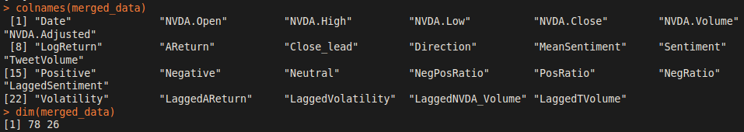
Ready for Modelling
Dataset is numeric, compact, error‑free.
Anthony trains the SVM, Travis builds visuals.
Hand‑off to Anthony on next slide.

Slide 12
Exploratory Data Analysis

Slide 13
Exploring the data
IMPORTANCE:
Provides a
Clear
Concise
Understandable
Visual representation of possible patterns
There may happen to be a common factor between NVidia stock prices and twitter tweet sentiments.
REMINDER:
Correlation does not mean causation!

Slide 14
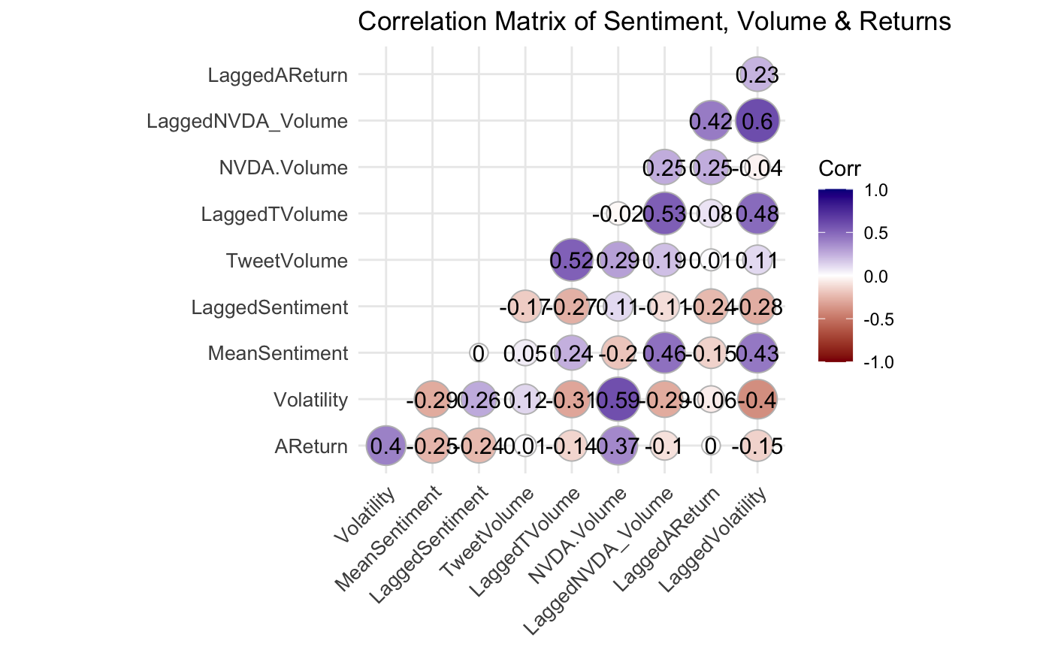
Correlation Matrix

Slide 15
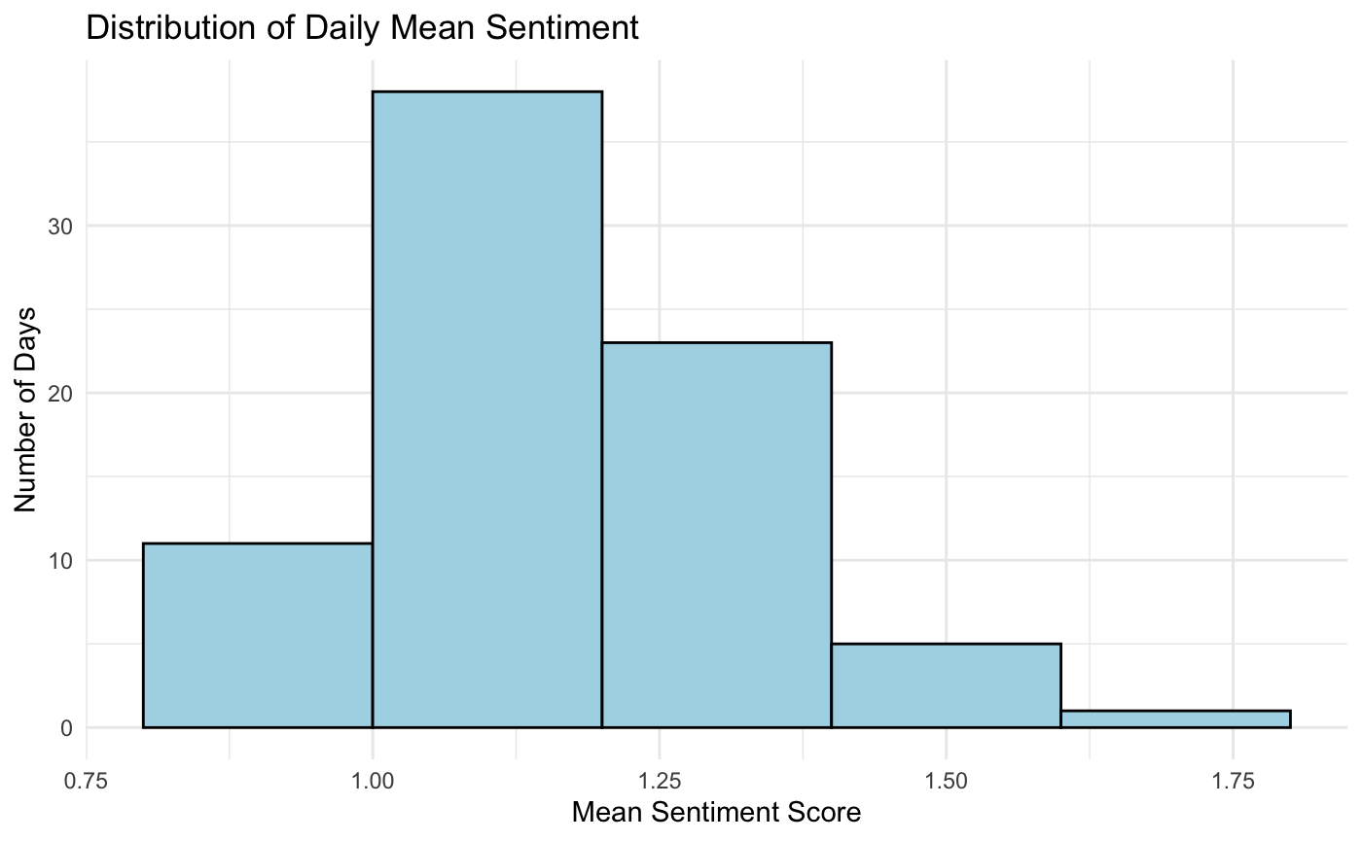
Daily Mean Sentiment

Slide 16
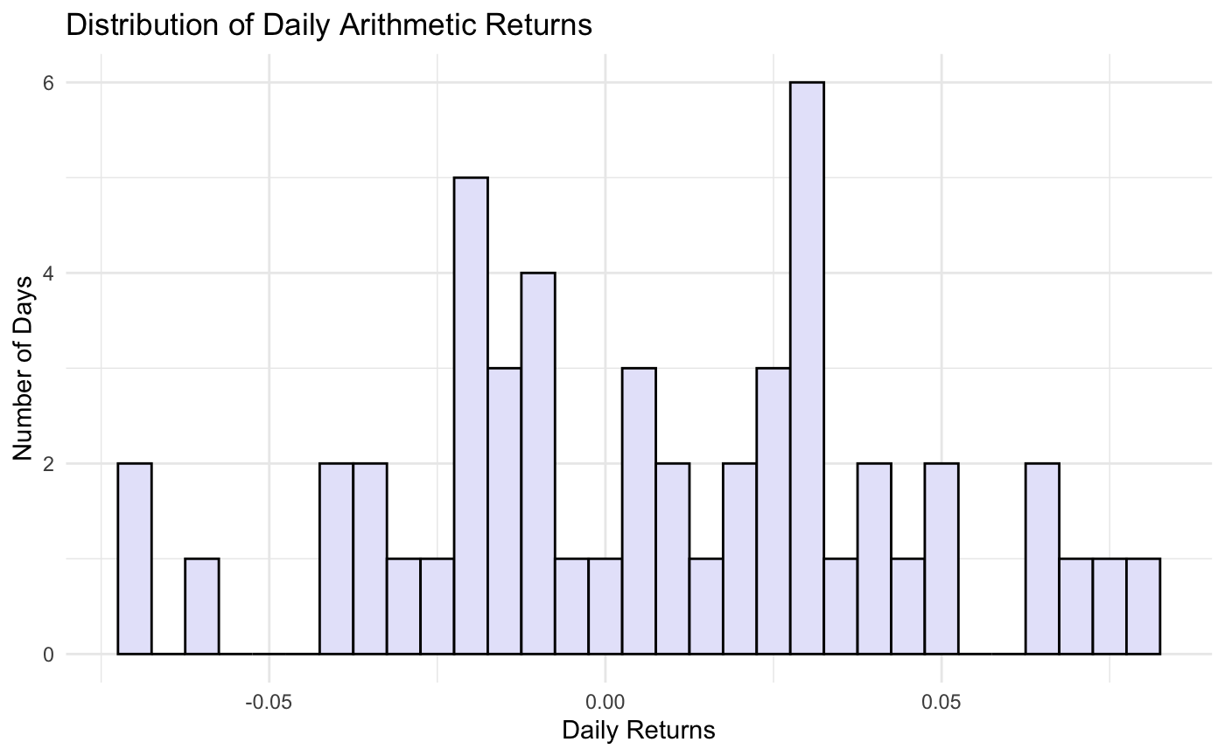
Histogram of Daily Returns

Slide 17
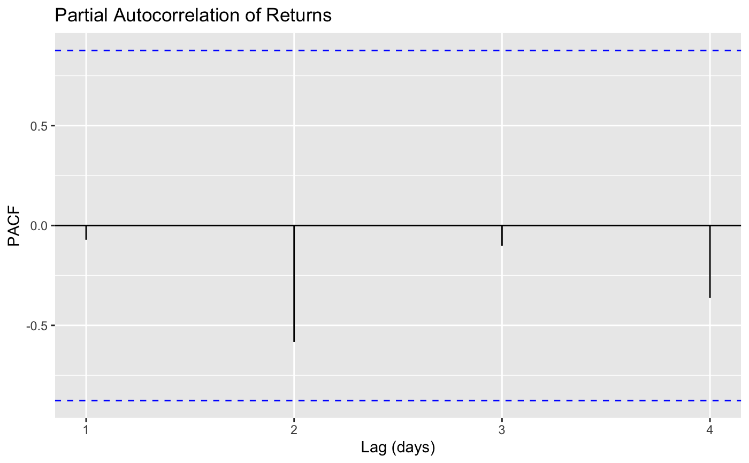
PACF

Slide 18
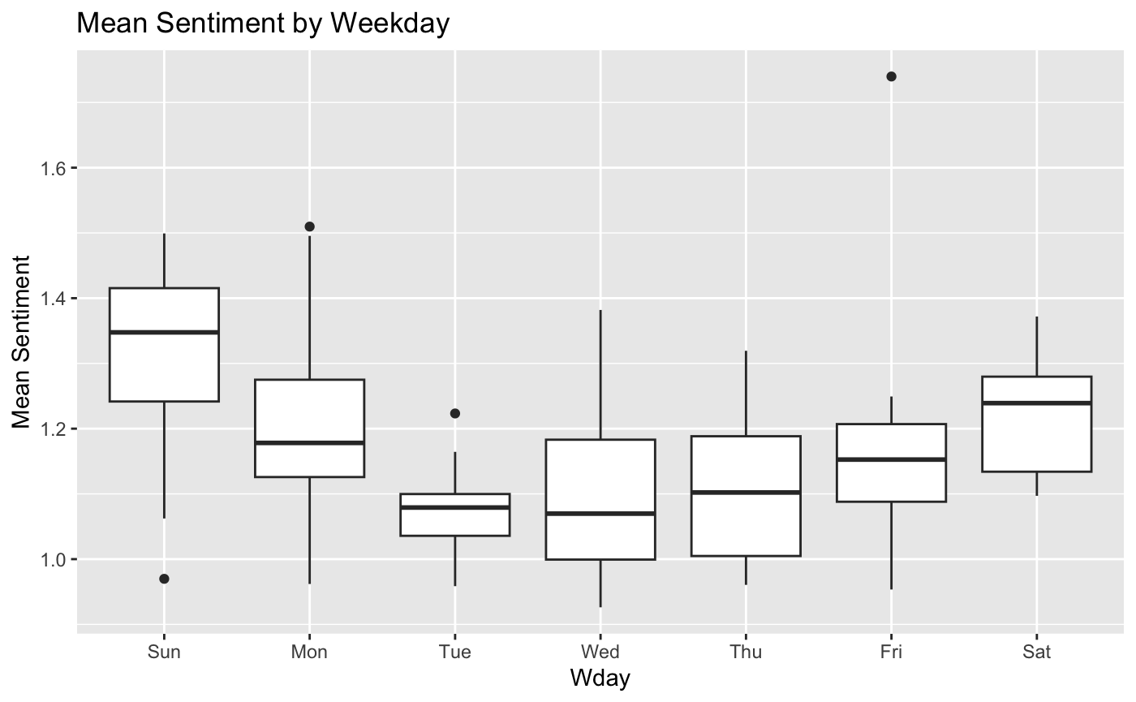
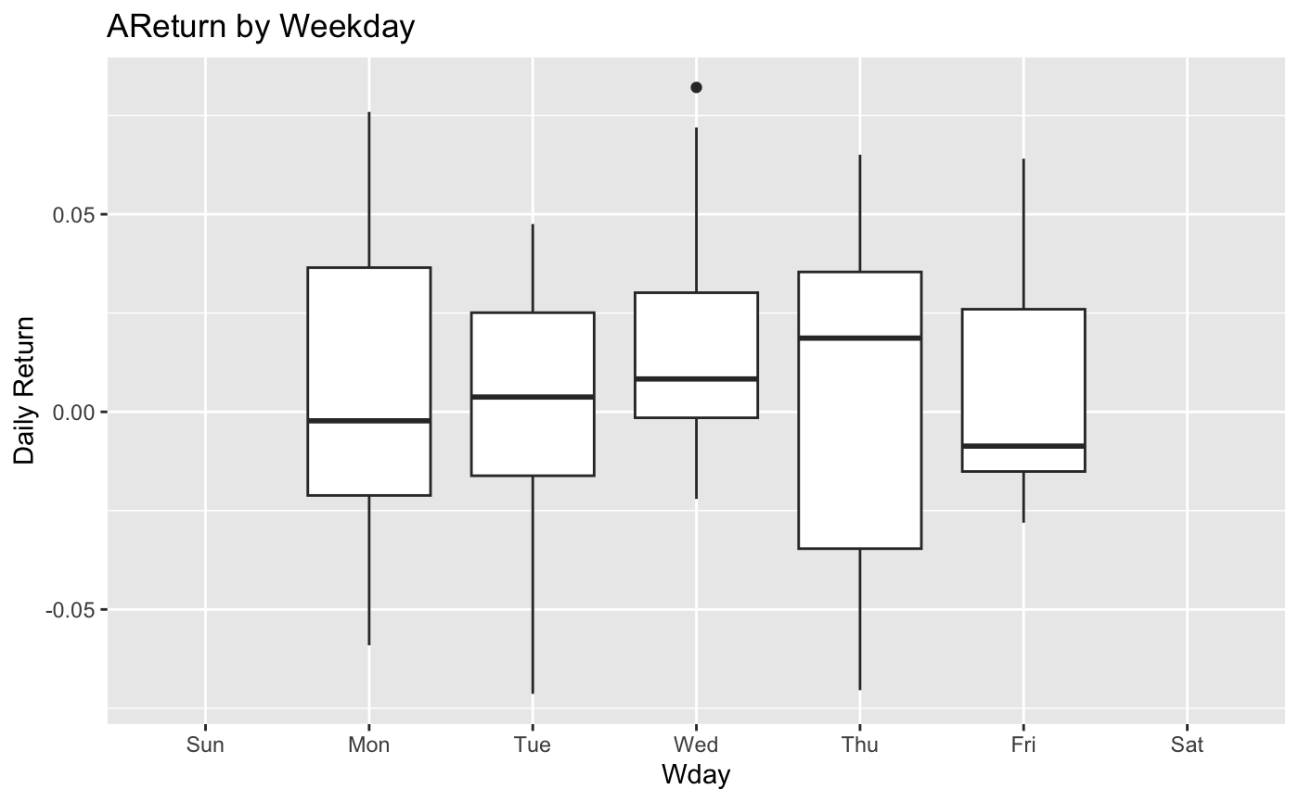
Sentiment & Returns by day

Slide 19
Takeaway from data analysis
Cross series correlation test for tweet volume and nvidia volume has r ~ 0.6
Cross series correlation test on mean sentiment and returns has r < 0.1

Slide 20
Exploring Using SVM Modelling

Slide 21
Goal of the Mining (In relation to SVM)
Objective: Predict the direction (Up/Down) of NVDA stock prices using public sentiment from tweets.
Approach: Combine social media sentiment analysis with stock market data to frame a binary classification problem.
Tools Used: Sentiment lexicon analysis, stock price return calculations, SVM modeling; both linear and radial, to test predictions within the dataset and beyond.

Slide 22
Patterns and Insights Found
Sentiment Data:
Stock Behavior vs. Sentiment:
During the study period, tweets showed no net negative sentiment across days.
Public perception of NVDA remained consistently positive, limiting sentiment diversity.
Despite real fluctuations in NVDA’s stock price, sentiment data remained one-sided, reducing predictive power.
Static daily analysis missed momentum or volatility trends often seen in real market movements.

Slide 23
Modeling Results
Linear SVM:
Radial SVM (after tuning):
Accuracy was lower than random guessing; model biased towards predicting stock price would go Up.
Accuracy matched random guessing; still failed to predict price decreases.
Due to the only-positive sentiment, as the radial models progressed, they only predicted the stock prices to increase.

Slide 24
Why the Findings Matter
Highlights that social sentiment, when overly positive or lacking diversity, is not sufficient for predicting financial markets.
Shows that market movements are driven by multiple factors, not just public opinion.
Demonstrates the importance of checking for class imbalance and understanding when models are simply guessing the majority class.
Encourages critical evaluation of machine learning models beyond just reported accuracy.

Slide 25
Real-World Application of This Knowledge
Investment Strategy Design:
Social Media Monitoring:
Caution against relying solely on social media sentiment for stock prediction models.
Better models should incorporate financial indicators, market trends, and news events alongside sentiment.
While limited for direct price prediction, trend tracking of sentiment can still inform investor sentiment analysis and risk assessment.

Slide 26
Final Conclusions to SVM Analysis
Single-source, positively skewed sentiment data limited the ability to predict stock movement accurately.
The positively skewed sentiment data caused the predictive models to overcompensate, leading to the conclusion that markets may only go up when there is a positive sentiment; which, in this case, is 100% of the time, causing the low accuracy rate.
For future success, stock prediction models must include richer data sources and time-aware modeling techniques.

Slide 27
Shiny App

Slide 28
Purpose of the Shiny App
Explore relationship between Twitter sentiment and Nvidia stock prices
Allow dynamic filtering and visualization
Support financial analysis through interactive tools

Slide 29
Key Features
Date range selector
Sentiment type filter: Positive, Negative, All
Three main plots: Sentiment, Stock Price, Combined View

Slide 30
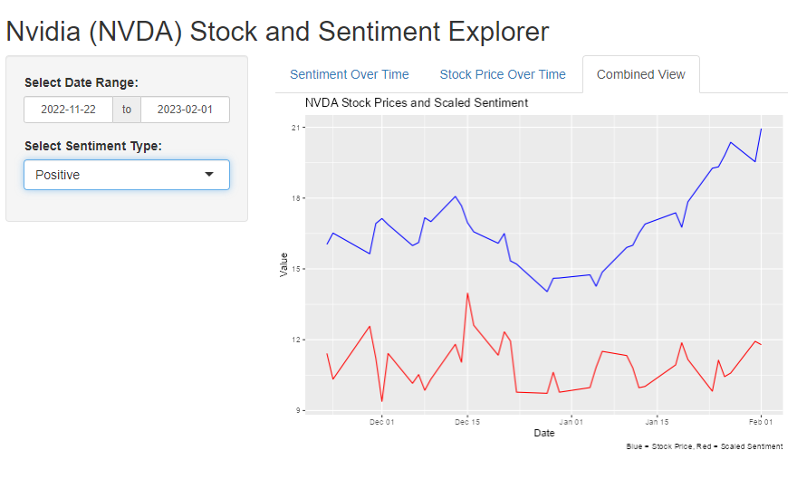
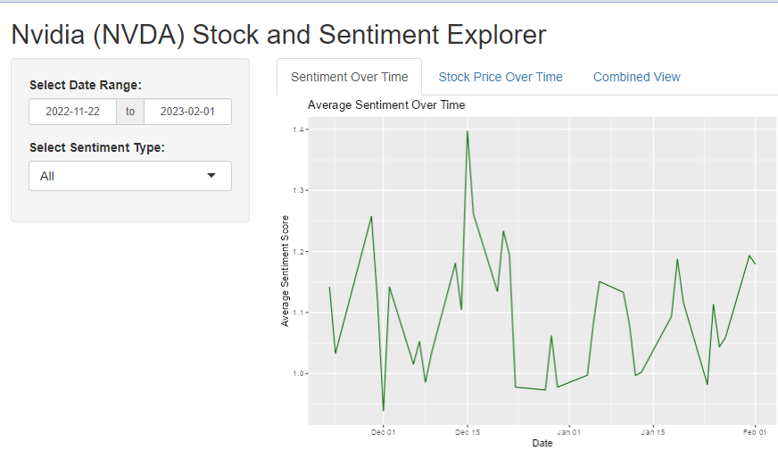
Visual Outputs
Sentiment over time (green line)
Stock closing price over time (blue line)
Combined stock price and sentiment (blue + red lines)

Slide 31
Insights Gained
Positive sentiment sometimes aligns with stock increases
Stock prices influenced by multiple factors beyond sentiment
Visualization helps reveal hidden patterns and exceptions

Slide 32
Conclusion
Key Findings:
Positive Twitter sentiment sometimes aligned with stock price increases.
However, stock prices are influenced by multiple factors beyond sentiment.
Single-source, positively skewed sentiment limited prediction accuracy.
Challenges Identified:
Class imbalance: Sentiment data was overwhelmingly positive (~100%), biasing the models.
Model performance:
Accuracy was lower than random guessing.
SVM models overpredicted "Up" movements due to lack of sentiment diversity.
Static daily analysis missed market momentum and volatility trends.

Slide 33
Lessons Learned:
Social media sentiment alone is insufficient for accurate stock prediction.
Stronger models require combining sentiment with financial indicators, market trends, and news events.
Critical evaluation is essential: Always check for class imbalance and avoid relying solely on accuracy metrics.
Practical Implications:
Sentiment analysis is still valuable for investor mood tracking and risk assessment.
Encourages richer, multi-source data and time-aware modeling for better financial forecasting.
Reminds analysts to stay cautious when interpreting machine learning models in real-world applications.

